Slide 1
Self Service Patterns in Digital Channels
Ramkumar R
Ramkumar.r@blueconchtech.com
24th November 2021

Slide 2
Presentation Flow
Self Service Rationale for Users & Customers
Self Service Rationale for Businesses
What are Software Patterns
Gang of Four Design Patterns
What is a Pattern Language
Pattern Language for Information Security : An example
Self Service Pattern Language : Focus of this presentation
Problem Statement for Digital Customer Self Service
Forces that result in Self Service
Pattern Template
Types of Digital Self Service Patterns
Behavior Patterns – Deep Dive
Aid Patterns – Deep Dive
Channel Patterns – Deep Dive
Customer Patterns – Deep Dive
Relationship Patterns – Deep Dive

Slide 3
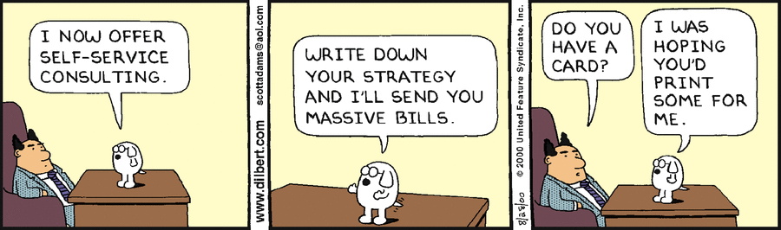
Some Humor to lighten Self Service

Slide 4
Self Service Rationale for Customers
Customers are digitally savvy or native
Customers are well connected due to increasing penetration of the internet and high end devices
Increasing information richness due to big data means customers can find the knowledge themselves
Customers do not want to wait for service agent due to the hold time
AI has matured to the extent that intelligent self service is possible
67% of customers said that they prefer to use self-service options rather than speaking with a company representative.
Additionally, around 85% of customers say that they’ll choose the self-service route above any other option.

Slide 5
Self Service Rationale for Businesses
Self Service reduces transaction costs by 1/10th of a normal human interaction
Self Service improves overall customer experience quality like speed and satisfaction.
Self Service improves customer loyalty
Self Service improves Availability
90% of e-commerce customers expect Self Service
Self Service can be easily secured, centralized and scaled
Self Service helps the employees to move away from routine business tasks

Slide 6
What are Software Patterns
In software engineering, a software design pattern is a general, reusable solution to a commonly occurring problem within a given context in software design.
It is not a finished design that can be transformed directly into source or machine code.
Rather, it is a description or template for how to solve a problem that can be used in many different situations. Design patterns are formalized best practices that the programmer can use to solve common problems when designing an application or system.

Slide 7
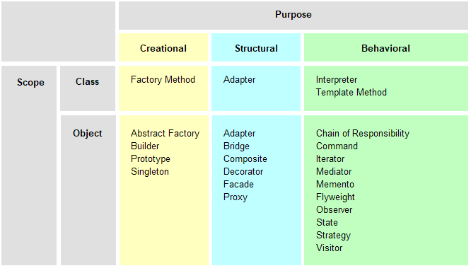
Software Engineering Example : Gang of Four Design Patterns

Slide 8
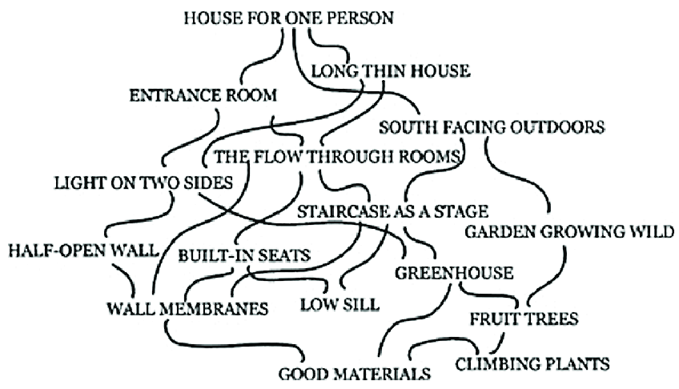
What is a Pattern Language
A pattern language is an organized and coherent set of patterns, each of which describes a problem and the core of a solution that can be used in many ways within a specific field of expertise. The term was coined by civil architect Christopher Alexander and popularized by his book A Pattern Language as reproduced below
Civil Engineering and Architecture Patterns

Slide 9
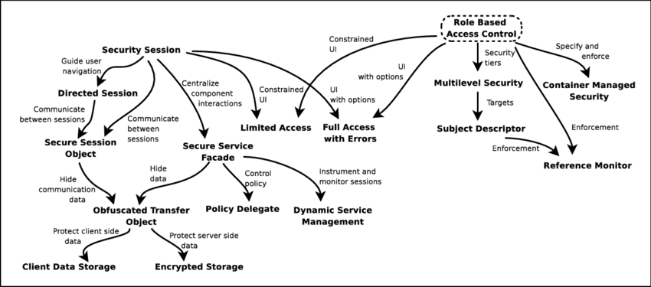
Pattern Language for Information Security : An example

Slide 10
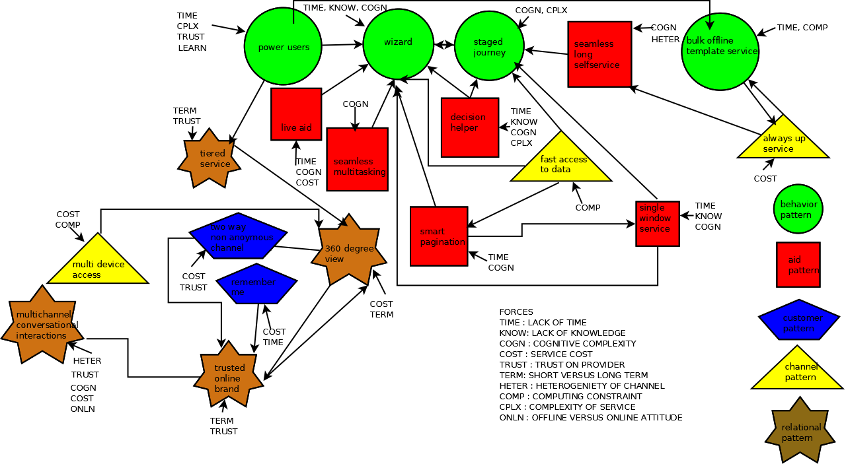
Self Service Pattern Language : Focus of this presentation

Slide 11
Defining the problem statement for Digital Self Service
Customers engage in Behaviors to satisfy Objectives with Aids on the Channel to build Relationships on Digital Channels (CBOACR)

Slide 12
Forces that result in Self Service
Lack of Time
Lack of Knowledge
Computing Constraints
Complexity of Steps or Interactions
Cognitive Constraints
Complexity of Self Service Objectives
Timing of Self Service Objectives
Cognition, Perception and Deciphering of Aids
Learning Effects
Channel Capacity
Channel Heterogeneity
Service Cost
Short Term versus Long Term
Offline attitude versus online experience
Trust

Slide 13
Pattern Template : How to identify a design pattern in the context?
Context
Specific context : In what environment(s) do we see this problem?
Problem: What is the problem we are trying to solve?
Example: An example of the problem
Forces: What makes the problem hard to solve
Solution : How we solve the problem?
Solution example : Two examples
Resulting Context : The environment created by the resolution of the problem
Related Patterns : Other Patterns
Known Uses : Examples in Real Systems
Negative Consequences: Does this pattern have negative consequences? If so what is the mitigation?
Illustration : A picture of the pattern in real use
x

Slide 14
Types of Digital Self Service Patterns
Behavior Patterns
Bulk Offline Template Service
Staged Journey
Wizard
Power Users
Aid Patterns
Decision Helper
Single Window Service
Live Aid
Seamless Long Self Service
Seamless Multitasking
Customer Patterns
2 way non anonymous channel
Remember Me
Channel Patterns
Fast Access to Data
Multi-Device Access
Always Up Service
Relationship Patterns
Multi-Channel Conversational Interactions
360 Degree View
Trusted Digital Brand
Tiered Service

Slide 15
Behavior Patterns : Deep Dive

Slide 16
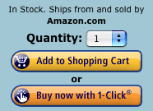
Behavior Pattern : Power Users
Context
Specific context : Users want better self service as they grow used to the channel and existing self service interfaces
Problem: How to enable customers to chose better methods of self service given the same set of service options meeting the customer objectives?
Example: For example users may want to pay their bills with one click.
Forces: Lack of Time, Complexity, Learning effects, Trust
Solution :Create an interface option that allows bypassing some self serve choices.
Resulting Context : A faster self service experience for experience users.
Related Patterns : Tiered Service
Known Uses :E-commerce often stores credit card information for reuse.
Negative Consequences: The pattern may increase the mistakes that can be made by the unaware, so some caution must be applied for self service tasks that cannot be reverted. For example they may auto-renew services they no longer need or even these journeys may not be childproof.
Solution example :A checkbox for power users that allows bypassing repetitive self serve.

Slide 17
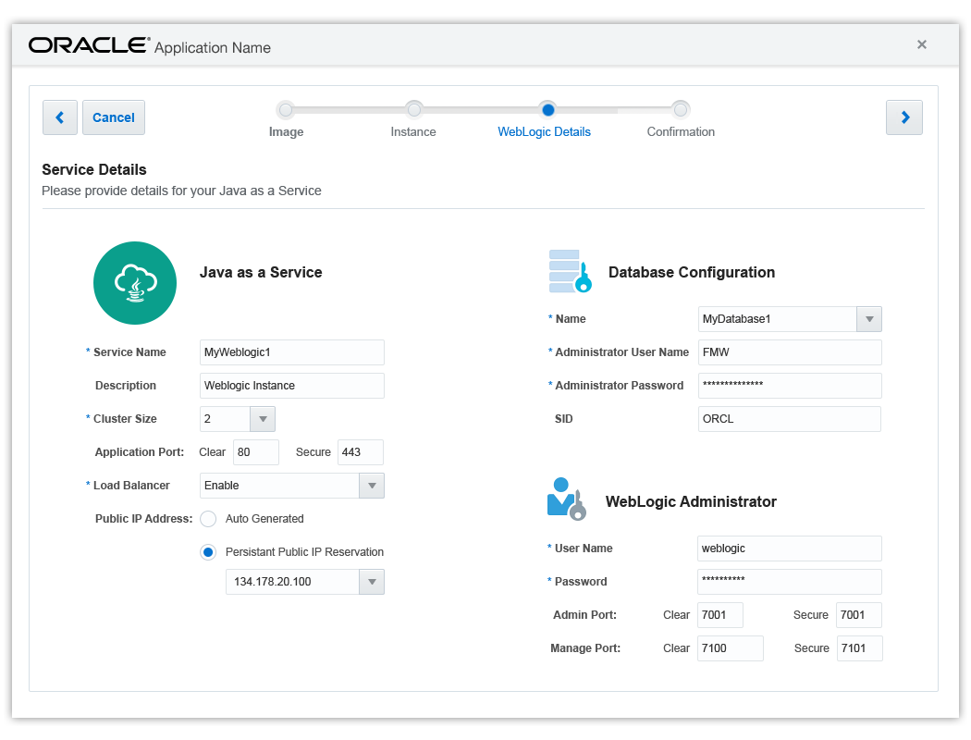
Behavior Pattern : Wizard
Context
Specific context : Multi-step complex memory based and domain aware behavior needed to satisfy objectives. User has to make informed decisions on a variety of self serve tasks
Problem: How to ensure the adequate information is provided the user to make the correct decisions on a variety of self serve tasks?
Example: User needs to select a specific energy plan (including green energy, his or her insulation needs) on an energy website.
Forces: Lack of Time, Lack of Knowledge, Cognitive Complexity
Solution : Create an intelligent wizard that embodies different decision models and guides the users.
Resulting Context : Fast selection among complex decision options.
Related Patterns : Staged Journey
Known Uses : Configuring cloud instances on Amazon cloud servers often provides wizards. Some sales tools that generate customer proposals like Bigmachines will automatically detect sales of conflicting hardware and software.
Negative Consequences: It is often possible that the users click rapidly through all the elements of a wizard like interface unaware of changes that occur. For example, they could select a software configuration which is ill suited for them. To mitigate the same Wizards should include warnings and provide auto-detection functionality. They should also provided standard automated solutions for normal users.
Solution example :User has a energy plan wizard which guides them through an optimal path for selecting their energy plan based on cost, their environment and past energy bills

Slide 18
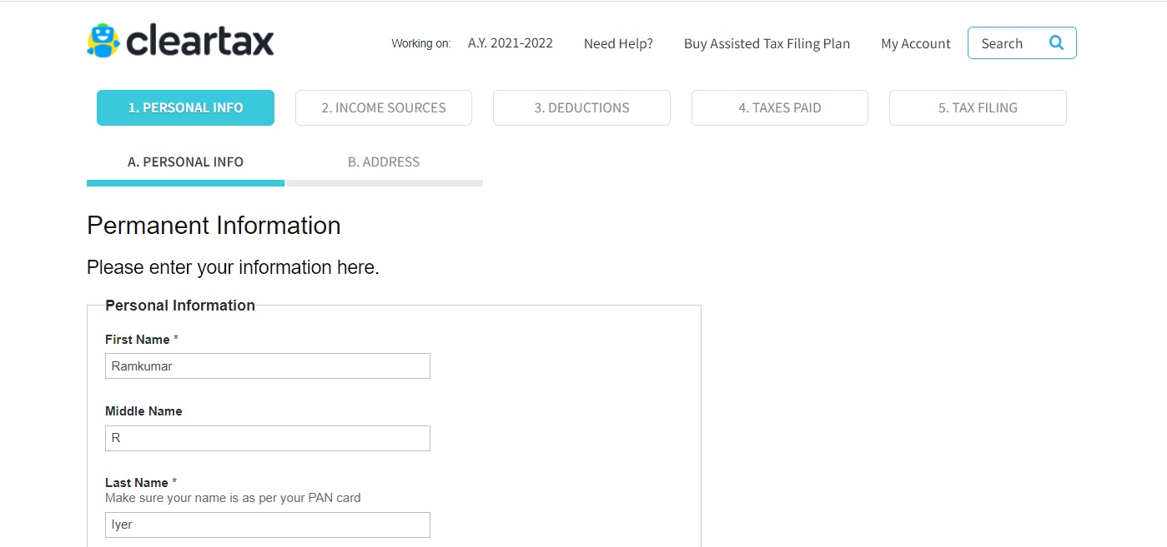
Behavior Pattern : Staged Journey
Context
Specific context : Multi-step complex memory based behavior needed to satisfy objectives. Customer has to complete lots of tasks in a sequential order. He or she may be interrupted and may need to resume at a certain place
Problem: How to ensure such a complex multiple steps self serve task can be executed?
Example: When we need to register a user a multitude of information may be asked in self serve. Customer may not have some information handy and there will be considerable think times.
Forces: Customers may often lose track of where they are in a long process involving multiple steps. The two forces are cognitive constraints and complexity of steps.
Solution : The solution consists of multiple sub solutions. Model the problem as a journey with stops in between. Provide intermediate feedback. Store the state at every stop.
Solution example :A stage wise journey form with collapsible sections on multiple pages.
Resulting Context : A progressive solution to the self serve problem
Related Patterns : Wizard
Known Uses :Many ATM machines use a journey pattern
Negative Consequences: If a journey pattern is used, journeys tend to get longer for complex problems and the user may feel frustration. This can be mitigated by keep journeys small and chaining them.

Slide 19
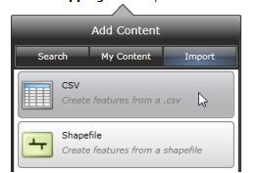
Behavior Pattern : Bulk offline template service
Context
Specific context : Environments where multiple repetitive self serve tasks ranging beyond 5-10 tasks
Problem: The customer has to complete lot of self serve tasks but the number of tasks is too high
Example: A user may need to submit a 100 meter reads to an energy utility for all the businesses he or she owns.
Forces: Lack of Time, Computing Constraints
Solution : Create a template for multiple self serve tasks and allow the template to be filled in offline and submit at a single shot
Solution example :A template is provided to the user with header. This template can be a comma separated value file. The comma separated value file can be uploaded with the meter reads and meter identification numbers is submitted.
Resulting Context : User is able to automate multiple self serve tasks using provided templates.
Related Patterns : Power User
Known Uses : Money management software has power users who can upload their bills. Social management software also allows import and export of contacts.
Negative Consequences: This introduces a complexity with respect to maintaining compatible file interchange formats. The template that users fill in with data need to validated. As mitigation we can consider simple interchange formats.

Slide 20
Aid Patterns : Deep Dive

Slide 21
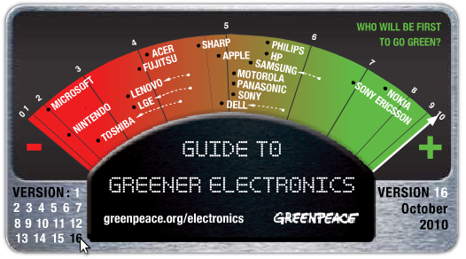
Aid Pattern : Decision Helper
Context
Specific context : Choice among competing options with weights attached to each attribute of the option.
Problem: Customer has to make choices between various self service options.
Example: Customer has to choose between different payments plans like monthly, yearly. Choose insurance policies. Choose types of train tickets at a railroad.
Forces: Lack of time, Lack of Knowledge
Solution :Create tabular comparison sheets with the overall cost highlighted
Resulting Context : Reduction in time to make decision. More optimal decisions
Related Patterns : Journey
Known Uses : Tables, Graphs, Charts are used in Intuit Money Manager to show split among multiple items
Negative Consequences: The decision aids provided to the user should be easily decipherable across various cultural barrier. It is rare for one decision aid to actually help the user so multiple decision aids should be provided.
Solution example :A table displaying various payment plans. A graph comparing various options

Slide 22
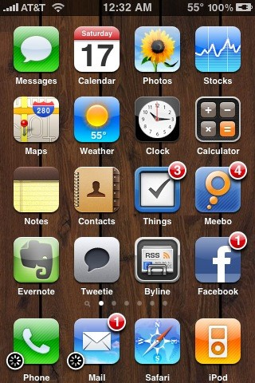
Aid Pattern : Single Window Service
Context
Specific context : Display multiple self serve options to the customer
Problem: How can multiple self serve options displayed to a customer efficiently?
Example: Customer has a 100 self serve options like pay bill, view energy consumption, move premises etc. How to display them efficiently?
Forces: Lack of time, Lack of knowledge, Cognitive Constraints
Solution :Create a navigational system that helps the user to navigate between all the self serve options without losing the context and having to load multiple pages
Resulting Context : One stop self serve place which is easily book-markable.
Related Patterns : Wizard
Known Uses : MegaMenu, Springboard, Faceted Navigation
Negative Consequences: In some cases it is difficult to show all the decision options in a single page so techniques like infinite scrolling and swipe based navigation are used to give feeling that all options are on the same page. However, in such cases the discovery of self service options will take time as the user manually has to navigate to each and every option
Solution example :Create a compact/condensed single page or faceted navigation system. This must go hand in hand with selecting the appropriate layouts which will be in line with the displays the customer may use to access the self serve system.

Slide 23
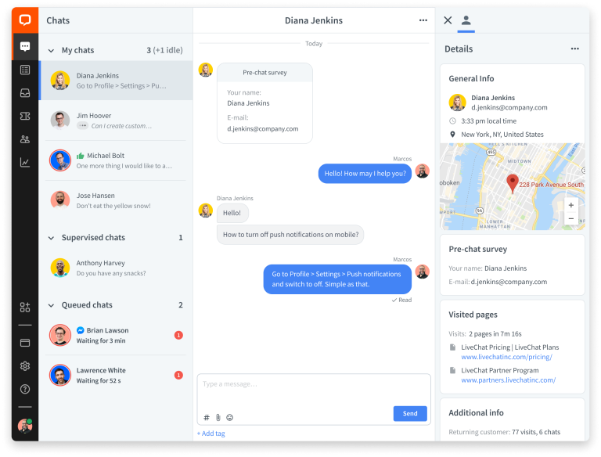
Aid Pattern : Live Aid
Context
Specific context : Current technologies cannot support immediate customer needs or the web channel is not optimized to provide the support the customer needs.
Problem: Customer may need immediate help while doing self serve. How can you avoid a costly switch to other channels and complete abandonment of the online channel?
Example: Customer has a complex question when accessing a self serve task. Maybe they do not understand the language or they are stuck
Forces: Time, Cognitive, Service Cost
Solution :Introduce human digital assistance
Related Patterns : Wizard
Known Uses : Websites like Samsung have chat line for their customer service
Negative Consequences: If such functionality exists, users may start using this any time and all the time thereby skipping the online self serve. The mitigation is to only provide the chat window to appear at appropriate complex positions in the online work flow, which is complex. The other negative consequence is that the chat window agent may have no idea of what the user is facing online. Some kind of mirror window could be opened to troubleshoot the customer problems. The third negative consequence is that there will be wait time required to provide the live aid. This can be mitigated by showing to customer how much time he/she has left to get live aid and also allow mechanism for the live aid to activate the channel to customer when customer is free.
Solution example :Customer and Smart context based digital chats
Resulting Context : Human assistance when really needed

Slide 24
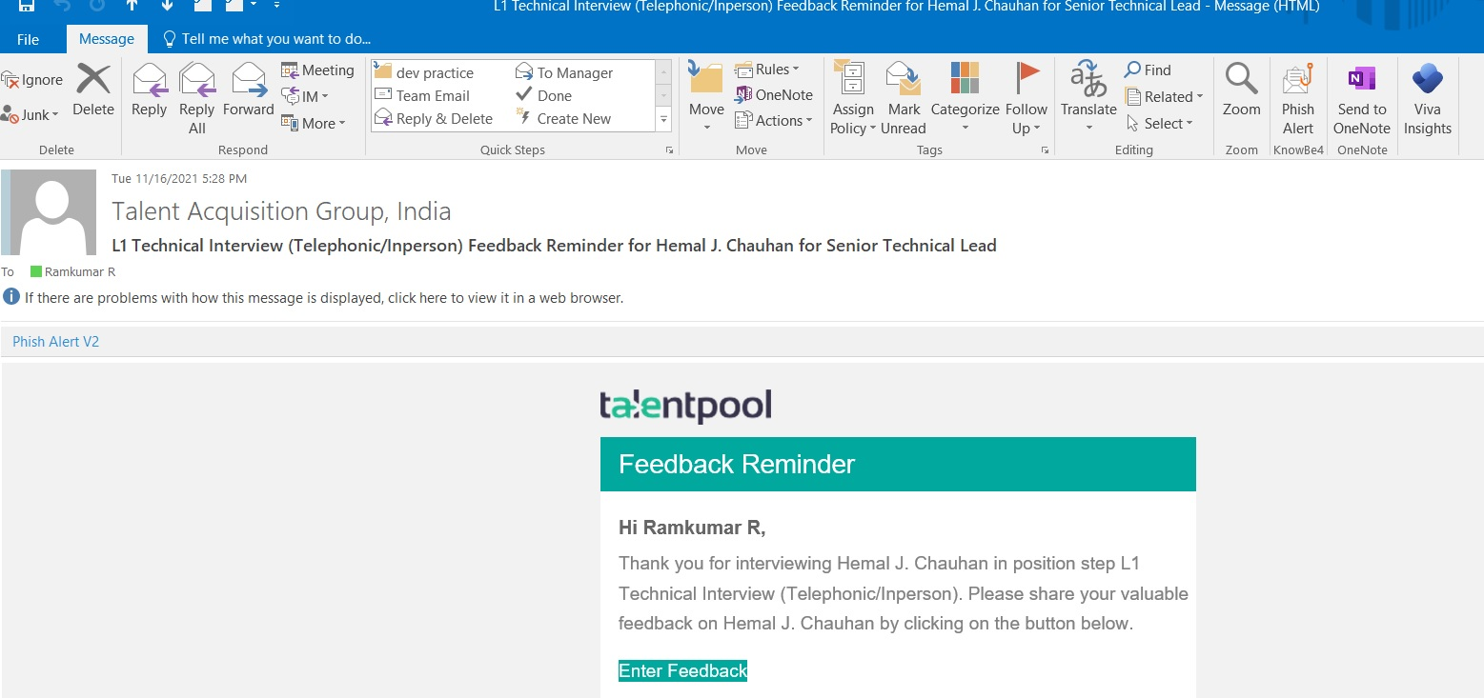
Aid Pattern : Seamless Long Self Service
Context
Specific context :Customers want to do long running transactions over periods of days .
Problem: Customer may need storage of intermediate steps or final steps of their transactions
Example: Customer wants to complete a moving premises task for a gas connection that takes a week. Customer wants to submit an appraisal form over a month.
Forces: Cognitive Constraints, Heterogeneity of channels
Solution : After customer completes part of a long running self serve task, send a message with a link to continue over other channels
Related Patterns : Staged Journey
Known Uses : Customer sells shares online and receives messages on SMS after one week that shares are sold.
Negative Consequences: The customer may have changed his or her mind or requirement in the midst of long running self serve tasks. The mitigation is to provide a cancellation mechanism. The customer might have forgotten about the long running self serve task. The mitigation is to provide enough context for him or her on the task status to proceed further.
Solution example : For example, customer can be sent an email after 15 minutes for a task of 1 hour with an intermediate state to continue later
Resulting Context : Seamless, long running. self serve access

Slide 25
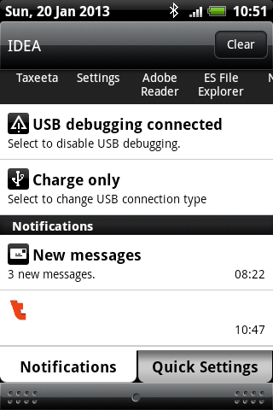
Aid Pattern : Seamless Multitasking
Context
Specific context :Customers are executing self serve tasks in parallel.
Problem: Customer may have performed or may need to perform many self serve tasks. How to keep the customers informed?
Solution : Message Center or Notification Center with task outputs.
Related Patterns : Live Aid
Known Uses : Facebook application on mobile has icons with cues of pending messages
Negative Consequences: The notification queue or message center or any other solution to the multitasking problem can be overloaded with too many messages/reminders/alerts some of which require urgent attention and some may do with lesser attention. Thus designers must take care to segregate these types of messages and also provide a solution to the user in order to delete unwanted notifications.
Resulting Context : Seamless multi task execution
Example: Customer does a payment which will take 15 minutes to be acknowledged. He also does a change of his password
Forces: Cognitive Complexity
Solution example : Design a notification queue or message center that allows customer to received delayed feedback on self serve tasks.

Slide 26
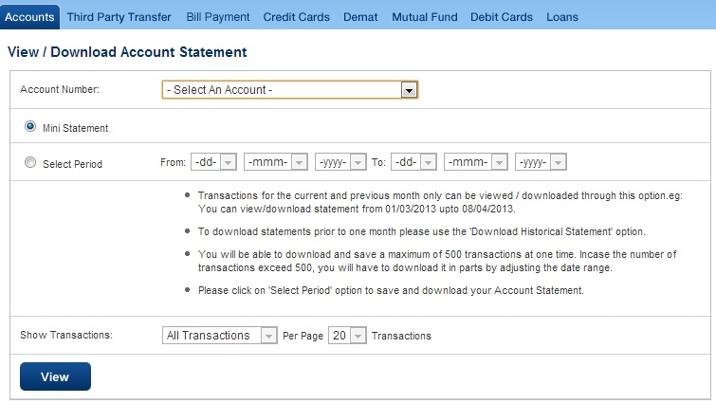
Aid Pattern : Smart Pagination
Context
Specific context :When customer has to view large volumes of data in multiple renderings
Problem: There is a lot of self service data for the customer. How to display it for good comprehension?
Solution : Create multiple pagination options or views. Allow the user to switch between these views. Make the most used view as the default view. If the customer makes persistent use of one of the views make that the default view.
Related Patterns : Wizard
Known Uses : HDFC bank allows quick account summary and account summary by period
Negative Consequences: If there are too many pagination options, user confusion may increase, seeing variety of ways they can see the data when they are interested in a few data. A decision aid is the mitigation for such a case.
Resulting Context : Multiple views of large volumes of data allowing for efficient selection.
Example: Customer wants to see top ten bills. Sometimes they want to see all their bills. Sometimes they want to see bills that they have paid.
Forces: Time Complexity, Cognitive Constraints
Solution example : Pagination by top ten bills, pagination by last 3 months, and pagination by payment status could be provided and it would also allow for sorting.

Slide 27
Channel Patterns : Deep Dive

Slide 28
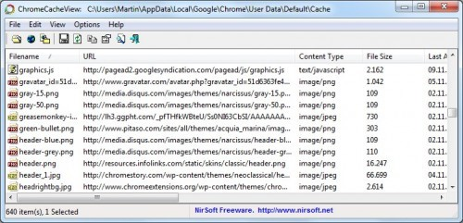
Channel Pattern : Fast access to data
Context
Specific context : Customer does repetitive self serve tasks on huge volumes of backend data
Problem: The customer may do multiple self serve actions. This results in costly backend calls to the system in terms of time and bandwidth. How do you enable customers to do repetitive self service tasks efficiently when large volumes of data are transferred over the online channel?
Example: Customer may want to view 100s of his bills, then go and buy a plan and view the bills again
Forces: Computing Constraints
Solution : Create a backend cache to store all the frequently used data for the customer right in the frontend making backend calls un-necessary and respond faster.
Resulting Context : Faster access to data
Related Patterns : Smart Pagination
Known Uses : Google docs caches customer data even if offline
Negative Consequences: Caches may quickly increase in size and may need to deleted for other programs to run smoothly especially in resource starved environments. Hence caching strategy should heavily depend on the nature of end device the customer is using and should be optimized. Caches also have to be secure.
Solution example : Store data in the browser for his bills till he comes back.

Slide 29
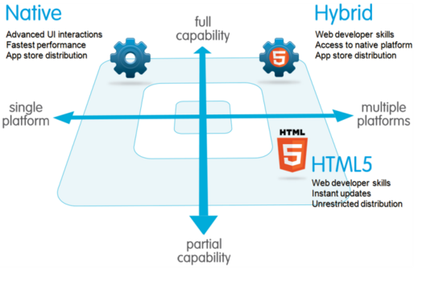
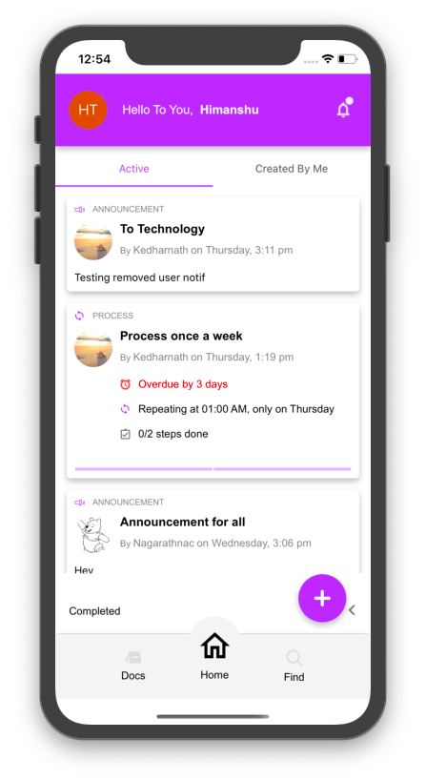
Channel Pattern : Multi-device access
Context
Specific context : Customer has multiple devices or multiple access channels
Problem: The customer may do multiple self serve access like devices on same channel: mobile, tablet, a browser. How to create a unique self serve across multiple customer devices?
Example: Customer has a tablet, a smart phone and a PC and wants to use same self serve application.
Forces: Computing constraints, Service Cost
Solution : A hybrid application supporting multiple devices is one which offers a customized online channel experience for various devices.
Resulting Context : Multi device access
Related Patterns : Smart Pagination
Known Uses : HDFC bank has a mobile app for payment across devices
Negative Consequences: Hybrid applications are not as fast and don’t have same look and feel as the native applications which may lead to a bad user experience. Hence look and feel and speed needs to be critically monitored for hybrid apps.
Solution example : An application store where customer can download a shrink wrapped hybrid app for their device for his specific device. The hybrid app mixes both the best features of a pure online access as well as allows for native feature access.

Slide 30
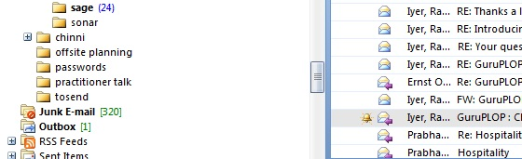
Channel Pattern : Always up service
Context
Specific context : Digital channels are not always available.99.9% is common.
Problem: Some customer self service operations may be down. How to ensure the completion of self service even when backend systems could be down?
Example: Some services like payments are down. How to still allow them?
Forces: Service Cost
Solution : Disconnected operation where self service task is queued till operations resume.
Resulting Context : Simulation of always up.
Related Patterns : Seamless Long Self-Service
Known Uses : Some mail clients will put mail in outbox and send when connection is available demonstrated in illustration below
Negative Consequences: When multiple customers access the same data and are offline they may make mutually incompatible changes. To mitigate these factors synchronization software needs to be written.
Solution example : Allow self service but commit the payment only when services are up. Customer sees no difference

Slide 31
Customer Patterns : Deep Dive

Slide 32
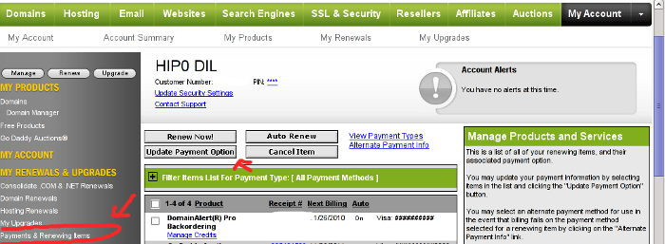
Channel Pattern : Remember Me
Context
Specific context : Customer preferences are lost when executing repetitive self serve tasks
Problem: If the customer is always treated as new customer then we lose valuable information about their preference like their cognitive style or decision preferences. How to ensure that the self service customer provides an interface that can learn over time?
Example: Customer wants to pay bill always with their same credit card.
Resulting Context : Customer feels like a known entity. Personalization occurs.
Related Patterns : 2 way non anonymous channel
Known Uses : E-commerce stores credit card information and other purchase information for reuse
Negative Consequences: The stored data of the customer must be constantly updated. He could have changed his credit card, moved premises, started to have different culinary taste between the time he expressed his preferences in the site and the time he accesses the site. To mitigate the preferences must allow for change from existing preferences.
Solution example : Store customers old credit card information securely and allow to use the same
Forces: Service Cost, Lack of Time.
Solution : Stores the likes, dislikes and the customer data and keep it updated. This can be leveraged when the customer executes the self service task repeatedly they execute new self serve tasks.

Slide 33
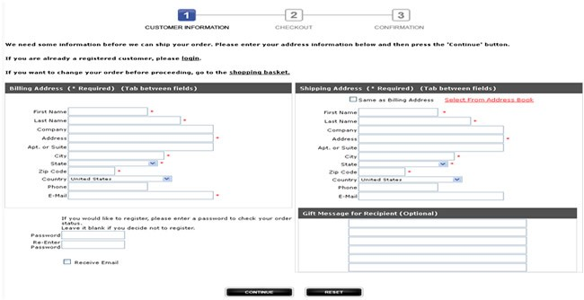
Channel Pattern : 2 Way Non Anonymous Channel
Context
Specific context : When the service provider needs two way communication but customer is anonymous
Problem: Anonymous customers cannot be provided optimized self service. How to ensure that end customers are not an anonymous entity in the online channel?
Example: Site wants to send a feedback on a self serve task but customer is anonymous
Resulting Context : 2 way communication happens
Related Patterns : 360 degree view
Known Uses : E-commerce stores allows anonymous bill pay as well as logged in bill pay. While logged in, users are shown additional usages and other efficient plans.
Negative Consequences: Once customer account management feature resulting in two way non-anonymous channel, the safety and security infrastructure needed at the backend also increases tremendously. To mitigate this strong security measures need to be put in backend including things like automatically changing passwords, CAPTCHAs and creating password reset infrastructure. Further customers start demanding increased service due to non anonymity which can be remedied by providing them with specialized items like coupons or lower bills. Some customers who prefer to be anonymous may need to be served so all critical self serve activities should have an anonymous mode.
Solution example : Login functionality capturing email and phone number
Forces: Service Cost, Trust
Solution : Create account management functionality which allows users to provide contact information as well as allows them to be. Thus the users are no longer anonymous.

Slide 34
Relationship Patterns : Deep Dive

Slide 35
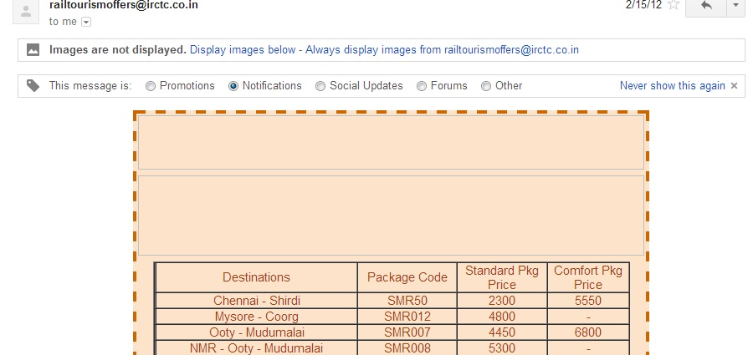
Customer Pattern : Multi-Channel Conversational Interactions
Context
Specific context : Customer does self serve and forgets the provider
Problem: Once the customer moves away from self serve, the self serve organization desires to build trust and relations. How to ensure that the self service provider is in the mind of the customer even after customer has finished the self serve task?
Example: Customer is not able to build long term relationship with self serve
Resulting Context : Customer feels part of 2 way conversation if the communication is personalized, individualized and dialogic
Related Patterns : 360 Degree View
Known Uses : IRCTC communicates customized rail packages to its known customers
Negative Consequences: The stored data of the customer must be constantly updated. He could have changed his credit card, moved premises, started to have different culinary taste between the time he expressed his preferences in the site and the time he accesses the site. To mitigate the preferences must allow for change from existing preferences.
Solution example : Email/SMS/Survey/Social/Ratings can be provided
Forces: Cognitive Complexity, Trust, Service Cost, Offline versus Online, Heterogeneity
Solution : Create a multichannel feedback allowing for relationships..

Slide 36
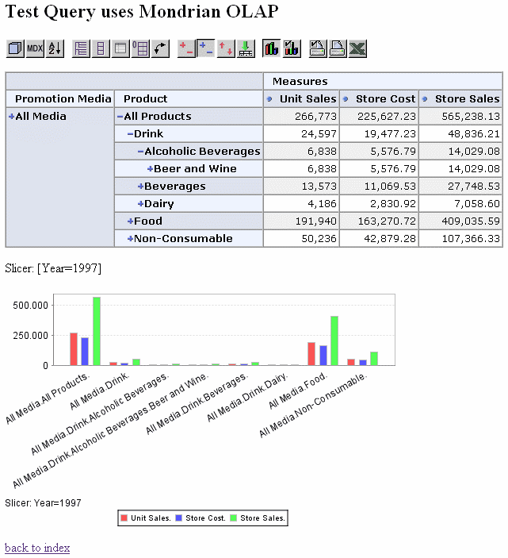
Customer Pattern : 360 Degree View
Context
Specific context : Some customers may use multiple channels to interact. How to build a relationship?
Problem: Customers interact with self service providers through various channels that may be transactional, relationship-based or social. Typically data regarding these interactions are in separate silos, thus the company cannot have an integrated view of the customer. We call such an integrated view, a 360 degree view of the customer. How does a system create 360 degree view of customer self serve to serve better?
Example: Some customers may call and pose a problem. Then they may go to a website and try to self serve and solve the problem. Then call back. They may post something about the self service task to a user forum. How to provide a unified view to service provider?
Resulting Context : Seamless access. Full information
Related Patterns : Trusted Online Brand
Known Uses : HDFC sends an SMS alert once you shop with debit/credit card, an alert when your salary is deposited and a end of month alert with bank-balances and an alert for third party transactions. They also allow to pay bills through the bank,
Negative Consequences: Building a 360 degree view is challenging and may raise privacy concerns. Further customer data from things like social networks is rich and unstructured and cannot be quantitatively measured. Also significant infrastructure is needed to host a 360 degree view. The mitigation is to gradually build the view from incoming data on cloud based services.
Solution example : A backend integrated CRM system
Forces: Service Cost, Short Term versus Long Term
Solution : Create a backend system with a multi channel 360 degree view.

Slide 37
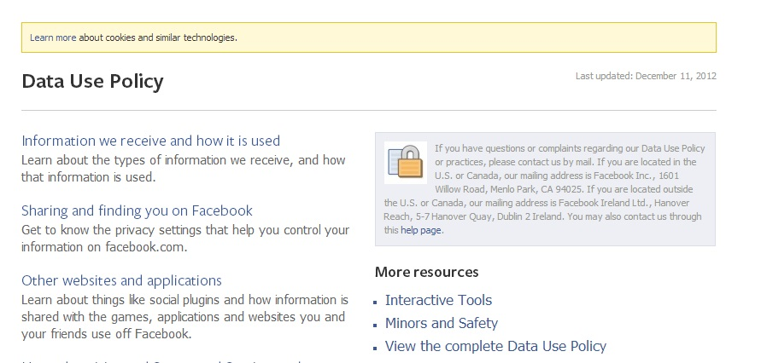
Customer Pattern : Trusted Online Brand
Context
Specific context : Customer trust is low in online channels
Problem: Customers feel revealing information to self serve websites may compromise their privacy. How to assure customers that their privacy won’t be compromised?
Resulting Context : More trust and cooperation will result if the company crafts a well defined policy and adheres to the same.
Related Patterns : 360 degree view
Known Uses :All websites have well defined privacy policies in their footer
Solution example : A cookie tracking policy
Solution : Create a well defined working privacy policy
Example: Customer does not trust a website with credit card information, personal details in fear they will be targeted or discriminated or robbed.
Forces: Short Term versus Long Term, Trust
Negative Consequences: Having no working privacy policy, means you can monetize the clicks the user makes on the site as well as build referral networks at cost of customer privacy. This could be suitable in rare cases. However having a working privacy policy entails you to not sell customer data to third party, not to track the customer unless it is with their explicit permission, which is better in long run.

Slide 38
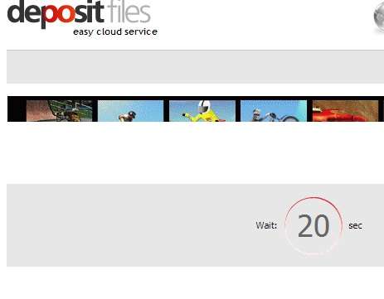
Customer Pattern : Tiered Service
Context
Specific context : There are multiple classes of segment-able users for the self service with different demands and differing capacities to pay for services. The resource on service provider side is limited.
Problem: How does the system serve some users at a different service level than others?
Resulting Context : People are served based on relationship value
Related Patterns : Trusted online brand : To ensure users don’t feel that some discrimination is happening
Known Uses :Some internet download providers like deposit files add a slight delay to free download customers.
Solution example : For example introduce a time delay for low paying customers who can afford to wait. We can also give discounts to customers who have used the online channel considerably more in the past as compared to other customers.
Solution : Provide various classes of self service differentiated in terms of time, quality or cost. Segment the users and assign each segment to a given class.
Negative Consequences: The drawback of this pattern is customers may not like being segmented to lower classes of service and migrate to other providers and the service provider must ensure that appropriate mechanisms to control for such backlash.
Example: Some customers are high paying or need a different class of self service and some are low paying for a file download website. How to differentiate?
Forces: Service Cost, Long term versus short term

Slide 39
Self Service Pattern Language : What we learnt?

Slide 40
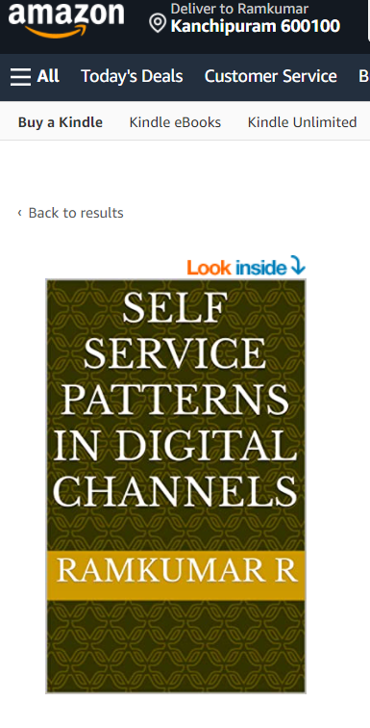
Also Available as a Kindle Book
https://www.amazon.com/Self-Service-Patterns-Digital-Channels-ebook/dp/B09KCC4G3V/

Slide 41
Thanks. Q&A

Slide 42




Together, let’s build for boundless impact
www.ust.com I www.blueconchtech.com

